Slide 1
CS633:Image Processing Module 1: Digital Image Fundamentals
Prof. Shailendra Kumar Sonkar
Assistant Professor, Department of Information Technology
University College of Engineering and Technology
Vinoba Bhave University Hazaribag, Jharkhand

Slide 2
Module - 1 Digital Image Fundamentals
Topics Covered
Introduction
What is Digital Image Processing?
The Origin of Digital Image Processing
Fundamental Steps in Digital Image Processing
Components of an Image Processing System
Digital Image Fundamentals
Elements of Visual Perception
Image Sensing and Acquisition
Image Sampling and Quantization
Some Basic Relationships Between Pixels
Color Models

Slide 3
Module - 1 Digital Image Fundamentals
Introduction
One picture is worth more than ten thousand words
Interest in digital image processing methods stems from two principal application areas
Improvement of pictorial information for human interpretation
Processing of image data for tasks such as storage, transmission, and extraction of pictorial information

Slide 4
Module - 1 Digital Image Fundamentals
What is Digital Image Processing?
An Image
A two-dimensional function, f (x, y)
Where x and y are spatial (plane) coordinates
The amplitude of f at any pair of coordinates (x, y) is called the intensity or gray level
A Digital Image
When x, y, and the intensity values of f are all finite, discrete quantities, image is called as a digital image
Composed of a finite number of elements, each of which has a particular location and value
These elements are called picture elements, image elements, pels, and pixels

Slide 5
Module - 1 Digital Image Fundamentals
What is Digital Image Processing?
A Digital Image
Pixel is the term used most widely to denote the elements of a digital image
Digital Image Processing
Processing digital images by means of a digital computer
A discipline in which both the input and output of a process are images
Includes processes that extract attributes from images
Including the recognition of individual objects

Slide 6
Module - 1 Digital Image Fundamentals
What is Digital Image Processing?
Digital Image Processing
Three types of computerized processes
Low Level Processes
Mid Level Processes,
High Level Processes
Low Level Processes
Involve primitive operations such as image preprocessing to reduce noise, contrast enhancement, and image sharpening
Characterized by the fact that both its inputs and outputs are images

Slide 7
Module - 1 Digital Image Fundamentals
What is Digital Image Processing?
Digital Image Processing
Mid Level Processes
Involves tasks such as segmentation (partitioning an image into regions or objects)
Description of those objects to reduce them to a form suitable for computer processing
Classification (recognition) of individual objects
Characterized by the fact that its inputs generally are images, but its outputs are attributes extracted from those images (e.g., edges, contours, and the identity of individual objects)

Slide 8
Module - 1 Digital Image Fundamentals
What is Digital Image Processing?
Digital Image Processing
High Level Processes
Involves “making sense” of an ensemble of recognized objects, as in image analysis,
Performing the cognitive functions normally associated with human vision

Slide 9
Module - 1 Digital Image Fundamentals
The Origin of Digital Image Processing
Introduction of the Bartlane cable picture transmission system in the early 1920s reduced the time required to transport a picture across the Atlantic from more than a week to less than three hours
Specialized printing equipment coded pictures for cable transmission, then reconstructed them at the receiving end
Figure 1.1 was transmitted in this way and reproduced on a telegraph printer fitted with typefaces simulating a halftone pattern

Slide 10
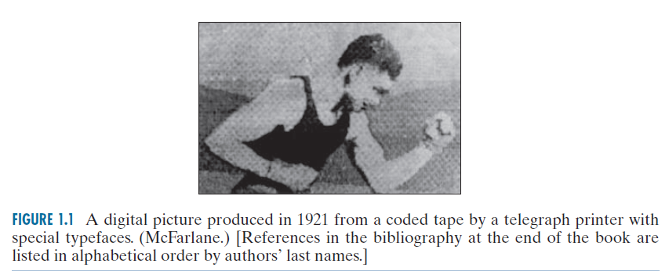
Module - 1 Digital Image Fundamentals
The Origin of Digital Image Processing

Slide 11
Module - 1 Digital Image Fundamentals
The Origin of Digital Image Processing
Some of the initial problems in improving the visual quality of these early digital pictures were related to the selection of printing procedures and the distribution of intensity levels
The printing method used to obtain Fig. 1.1 was abandoned toward the end of 1921 in favor of a technique based on photographic reproduction made from tapes perforated at the telegraph receiving terminal
Figure 1.2 shows an image obtained using this method
The improvements over Fig. 1.1 are evident, both in tonal quality and in resolution

Slide 12
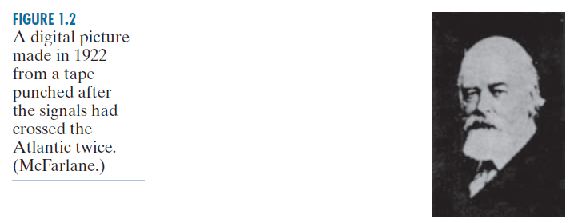
Module - 1 Digital Image Fundamentals
The Origin of Digital Image Processing

Slide 13
Module - 1 Digital Image Fundamentals
The Origin of Digital Image Processing
The early Bartlane systems were capable of coding images in five distinct levels of gray.
This capability was increased to 15 levels in 1929
Figure 1.3 is typical of the type of images that could be obtained using the 15-tone equipment.
During this period, introduction of a system for developing a film plate via light beams that were modulated by the coded picture tape improved the reproduction process considerably

Slide 14
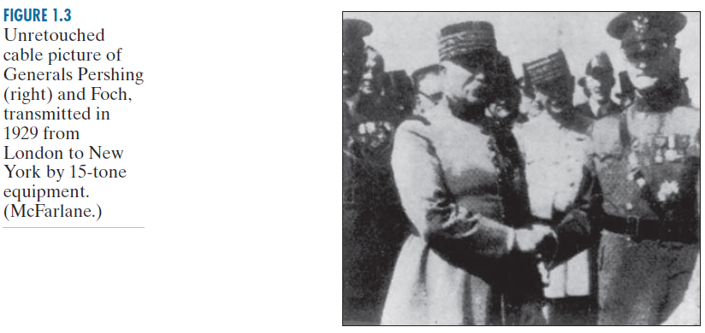
Module - 1 Digital Image Fundamentals
The Origin of Digital Image Processing

Slide 15
Module - 1 Digital Image Fundamentals
The Origin of Digital Image Processing
All the examples just cited involve digital images
Not considered digital image processing results
Digital computers were not used in their creation
History of digital image processing is intimately tied to the development of the digital computer
Digital images require so much storage and computational power
Progress in the field of digital image processing has been dependent on the development of digital computers and of supporting technologies that include data storage, display, and transmission

Slide 16
Module - 1 Digital Image Fundamentals
The Origin of Digital Image Processing
A modern digital computer dates back to only the 1940s, with the introduction by John von Neumann of two key concepts
A memory to hold a stored program and data
Conditional branching
These two ideas are the foundation of a central processing unit (CPU), which is at the heart of computers today
Starting with von Neumann, there were a series of key advances that led to computers powerful enough to be used for digital image processing

Slide 17
Module - 1 Digital Image Fundamentals
The Origin of Digital Image Processing
Briefly, these advances may be summarized as follows
The invention of the transistor at Bell Laboratories in 1948
The development in the 1950s and 1960s of the high-level programming languages COBOL (Common Business-Oriented Language) and FORTRAN (Formula Translator)
The invention of the integrated circuit (IC) at Texas Instruments in 1958

Slide 18
Module - 1 Digital Image Fundamentals
The Origin of Digital Image Processing
Briefly, these advances may be summarized as follows
The development of operating systems in the early 1960s
The development of the microprocessor (a single chip consisting of a CPU, memory, and input and output controls) by Intel in the early 1970s
The introduction by IBM of the personal computer in 1981

Slide 19
Module - 1 Digital Image Fundamentals
The Origin of Digital Image Processing
Briefly, these advances may be summarized as follows
Progressive miniaturization of components, starting with large-scale integration (LI) in the late 1970s, then very-large-scale integration (VLSI) in the 1980s, to the present use of ultra-large-scale integration (ULSI) and experimental nono technologies
Concurrent with these advances were developments in the areas of mass storage and display systems, both of which are fundamental requirements for digital image processing

Slide 20
Module - 1 Digital Image Fundamentals
The Origin of Digital Image Processing
The first computers powerful enough to carry out meaningful image processing tasks appeared in the early 1960s
The birth of what we call digital image processing today can be traced to the availability of those machines, and to the onset of the space program during that period
It took the combination of those two developments to bring into focus the potential of digital image processing for solving problems of practical significance

Slide 21
Module - 1 Digital Image Fundamentals
The Origin of Digital Image Processing
Work on using computer techniques for improving images from a space probe began at the Jet Propulsion Laboratory (Pasadena, California) in 1964
Pictures of the moon transmitted by Ranger 7 were processed by a computer to correct various types of image distortion inherent in the on-board television camera
Figure 1.4 shows the first image of the moon taken by Ranger 7 on July 31, 1964 at 9:09 A.M. Eastern Daylight Time (EDT), about 17 minutes before impacting the lunar surface

Slide 22
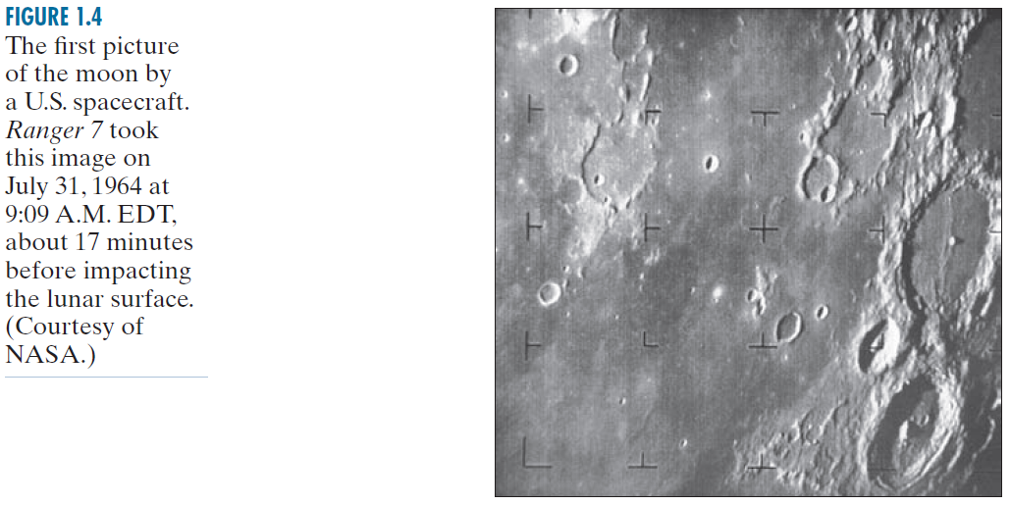
Module - 1 Digital Image Fundamentals
The Origin of Digital Image Processing

Slide 23
Module - 1 Digital Image Fundamentals
The Origin of Digital Image Processing
This also is the first image of the moon taken by a U.S. spacecraft
The imaging lessons learned with Ranger 7 served as the basis for improved methods used to enhance and restore images from the Surveyor missions to the moon, the Mariner series of flyby missions to Mars, the Apollo manned flights to the moon, and others
In parallel with space applications, digital image processing techniques began in the late 1960s and early 1970s to be used in medical imaging, remote Earth resources observations, and astronomy

Slide 24
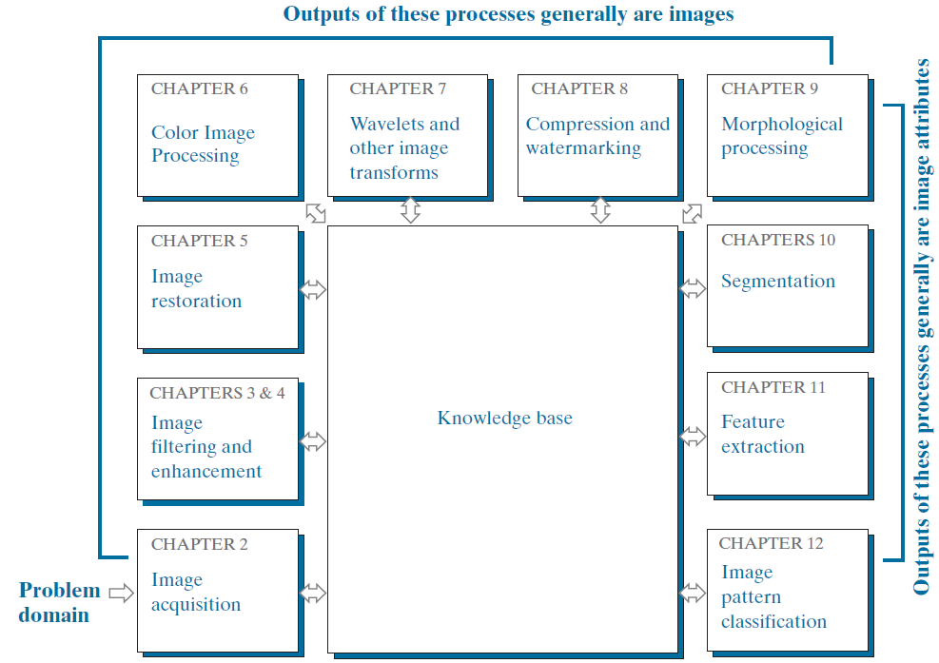
Module - 1 Digital Image Fundamentals
Fundamental Steps in Digital Image Processing
FIGURE 1.23 Fundamental steps in digital image processing.

Slide 25
Module - 1 Digital Image Fundamentals
Fundamental Steps in Digital Image Processing
Divide the material into the two broad categories
Methods whose input and output are images
Methods whose inputs may be images, but whose outputs are attributes extracted from those image
This organization is summarized in Fig. 1.23
The diagram does not imply that every process is applied to an image
All the methodologies that can be applied to images for different purposes, and possibly with different objectives

Slide 26
Module - 1 Digital Image Fundamentals
Fundamental Steps in Digital Image Processing
Image acquisition
Given an image that is already in digital form
The image acquisition stage involves preprocessing, such as scaling
Image enhancement
The process of manipulating an image so the result is more suitable than the original for a specific application
Enhancement techniques are problem oriented
for example, a method that is quite useful for enhancing X-ray images may not be the best approach for enhancing satellite images

Slide 27
Module - 1 Digital Image Fundamentals
Fundamental Steps in Digital Image Processing
Image restoration
Deals with improving the appearance of an image
Unlike enhancement, which is subjective, image restoration is objective
Restoration techniques tend to be based on mathematical or probabilistic models of image degradation
Enhancement is based on human subjective preferences regarding what constitutes a “good” enhancement result
Color image processing
Fundamental concepts in color models
Basic color processing in a digital domain
Color is used as the basis for extracting features of interest in an image

Slide 28
Module - 1 Digital Image Fundamentals
Fundamental Steps in Digital Image Processing
Wavelets
Foundation for representing images in various degrees of resolution
Used for image data compression and for pyramidal representation, in which images are subdivided successively into smaller regions
Compression
Deals with techniques for reducing the storage required to save an image, or the bandwidth required to transmit it
Image compression is familiar to most users of computers in the form of image file extensions, such as the jpg file extension used in the JPEG (Joint Photographic Experts Group) image compression standard

Slide 29
Module - 1 Digital Image Fundamentals
Fundamental Steps in Digital Image Processing
Morphological
Deals with tools for extracting image components that are useful in the representation and description of shape
Segmentation
Partitions an image into its constituent parts or objects
Autonomous segmentation is one of the most difficult tasks in digital image processing
A rugged segmentation procedure brings the process a long way toward successful solution of imaging problems that require objects to be identified individually
Weak or erratic segmentation algorithms almost always guarantee eventual failure
The more accurate the segmentation, the more likely automated object classification is to succeed

Slide 30
Module - 1 Digital Image Fundamentals
Fundamental Steps in Digital Image Processing
Feature extraction
Follows the output of a segmentation stage, which usually is raw pixel data, constituting either the boundary of a region (i.e., the set of pixels separating one image region from another) or all the points in the region itself
Consists of feature detection and feature description
Feature detection refers to finding the features in an image, region, or boundary
Feature description assigns quantitative attributes to the detected features
For example, we might detect corners in a region, and describe those corners by their orientation and location; both of these descriptors are quantitative attributes

Slide 31
Module - 1 Digital Image Fundamentals
Fundamental Steps in Digital Image Processing
Feature extraction
Feature processing methods are subdivided into three principal categories, depending on whether they are applicable to boundaries, regions, or whole images
Some features are applicable to more than one category
Feature descriptors should be as insensitive as possible to variations in parameters such as scale, translation, rotation, illumination, and viewpoint
Image pattern classification
The process that assigns a label (e.g., “vehicle”) to an object based on its feature descriptors
Methods of image pattern classification ranging from “classical” approaches such as minimum-distance, correlation, and Bayes classifiers

Slide 32
Module - 1 Digital Image Fundamentals
Fundamental Steps in Digital Image Processing
Image pattern classification
Modern approaches implemented using deep neural networks
Deep convolutional neural networks, which are ideally suited for image processing work
Knowledge base
Knowledge about a problem domain is coded into an image processing system in the form of a knowledge database
This knowledge may be as simple as detailing regions of an image where the information of interest is known to be located, thus limiting the search that has to be conducted in seeking that information

Slide 33
Module - 1 Digital Image Fundamentals
Fundamental Steps in Digital Image Processing
Knowledge base
The knowledge base can also be quite complex, such as an interrelated list of all major possible defects in a materials inspection problem, or an image database containing high-resolution satellite images of a region in connection with change-detection applications
It controls the interaction between modules
This distinction is made in Fig. 1.23 by the use of double-headed arrows between the processing modules and the knowledge base, as opposed to single-headed arrows linking the processing modules

Slide 34
Module - 1 Digital Image Fundamentals
Fundamental Steps in Digital Image Processing
viewing the results of image processing can take place at the output of any stage in Fig. 1.23
Not even all those modules are needed in many cases
As the complexity of an image processing task increases, so does the number of processes required to solve the problem

Slide 35
Module - 1 Digital Image Fundamentals
Components of an Image Processing System
General-purpose small computers with specialized image processing hardware and software
Figure 1.24 shows the basic components comprising a typical general-purpose system used for digital image processing
Image Sensors
Two subsystems are required to acquire digital images
Physical Sensor
Responds to the energy radiated by the object we wish to image
Digitizer
Device for converting the output of the physical sensing device into digital form
Specialized image processing hardware
Digitizer

Slide 36
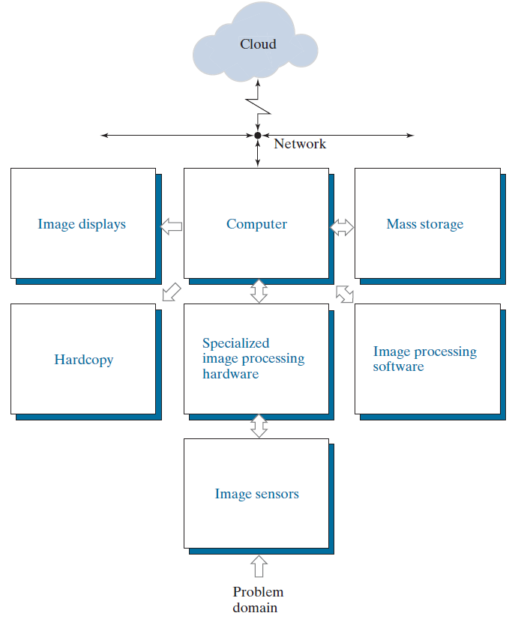
Module - 1 Digital Image Fundamentals

Slide 37
Module - 1 Digital Image Fundamentals
Components of an Image Processing System
Specialized image processing hardware
ALU(Arithmetic Logic Unit )
Performs arithmetic and logical operations in parallel on entire images
One example of how an ALU is used is in averaging images for the purpose of noise reduction
Called a front-end subsystem
Most distinguishing characteristic is speed
Performs functions that require fast data throughputs (e.g., digitizing and averaging video images at 30 frames/s)
One or more GPUs (Graphics Processing Units)
Perform intensive matrix operations

Slide 38
Module - 1 Digital Image Fundamentals
Components of an Image Processing System
Computer
A general-purpose computer
Range from a PC to a supercomputer
Software
Consists of specialized modules that perform specific tasks
A well-designed package
Includes the capability for the user to write code
Allow the integration of those modules and general-purpose software commands from at least one computer language
Commercially available image processing software, MATLAB® Image Processing Toolbox

Slide 39
Module - 1 Digital Image Fundamentals
Components of an Image Processing System
Mass Storage
Dealing with image databases that contain thousands, or even millions of images
Required adequate storage
Digital storage for image processing applications falls into three principal categories
Short-Term Storage
On-Line Storage
Archival Storage
Storage is measured
Bytes (Eight Bits)
Kbytes (10³ bytes)
Mbytes (10⁶ bytes)
Gbytes (10⁹ bytes)
Tbytes (10¹² bytes)

Slide 40
Module - 1 Digital Image Fundamentals
Components of an Image Processing System
Mass Storage
Short-Term Storage
Use during processing
Method of providing short-term storage
Computer Memory
Frame Buffers
Store one or more images
Accessed rapidly, usually at video rates (e.g., at 30 complete images per second)
The latter method allows virtually instantaneous image zoom, as well as scroll (vertical shifts) and pan (horizontal shifts)
Frame buffers usually are housed in the specialized image processing hardware unit
On-Line Storage
Relatively fast recall
Takes the form of magnetic disks or optical-media storage
Frequent access to the stored data

Slide 41
Module - 1 Digital Image Fundamentals
Components of an Image Processing System
Mass Storage
Archival Storage
Characterized by infrequent access
Characterized by massive storage requirements
Magnetic tapes and optical disks housed in “jukeboxes” are the usual media for archival applications
Image displays
Use today mainly color, flat screen monitors
Monitors are driven by the outputs of image and graphics display cards that are an integral part of the computer system
Hardcopy devices
Recording images include laser printers, film cameras, heat sensitive devices, ink-jet units, and digital units, such as optical and CD-ROM disks

Slide 42
Module - 1 Digital Image Fundamentals
Components of an Image Processing System
Networking and cloud communication
Almost default functions in any computer system in use today
Because of the large amount of data inherent in image processing applications, the key consideration in image transmission is bandwidth
In dedicated networks, this typically is not a problem, but communications with remote sites via the internet are not always as efficient
Fortunately, transmission bandwidth is improving quickly as a result of optical fiber and other broadband technologies
Image data compression continues to play a major role in the transmission of large amounts of image data

Slide 43
Module - 1 Digital Image Fundamentals
Elements of Visual Perception
Developing a basic understanding of human visual perception
Mechanics and parameters related to how images are formed and perceived by humans
Physical limitations of human vision in terms of factors that also are used in our work with digital images
Factors such as how human and electronic imaging devices compare in terms of resolution and ability to adapt to changes in illumination
Structure of the Human Eye
The eye is nearly a sphere
An average diameter of approximately 20 mm
Three membranes enclose the eye:
The cornea and sclera outer cover
The choroid
The retina

Slide 44
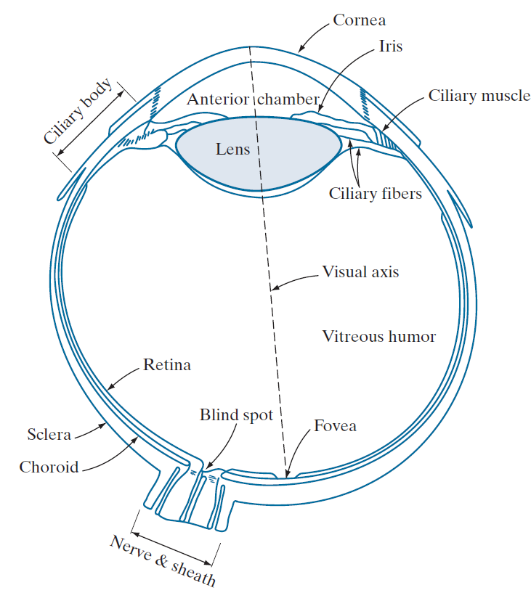
Module - 1 Digital Image Fundamentals
FIGURE 2.1 Simplified diagram of a cross section of the human eye.

Slide 45
Module - 1 Digital Image Fundamentals
Structure of the Human Eye
The cornea and sclera outer cover
The cornea is a tough, transparent tissue that covers the anterior surface of the eye
The sclera is an opaque membrane that encloses the remainder of the optic globe
The choroid
Lies directly below the sclera
This membrane contains a network of blood vessels that serve as the major source of nutrition to the eye
The retina
The innermost membrane of the eye is the retina, which lines the inside of the wall’s entire posterior portion
When the eye is properly focused, light from an object outside the eye is imaged on the retina
The eye ball
The eye ball is approximately spherical
The vertical measure of an eye ball is approximately 24 mm and is slightly less than the horizontal width
The eye offers a field of view covering 160º(width) × 135º height area

Slide 46
Module - 1 Digital Image Fundamentals
Structure of the Human Eye
Iris
The light entering the cornea is blocked by the visible colored and opaque surface of the iris
The back of the iris is coated with a black pigment
Pupil
The pupil is the opening at the center of the iris
The pupil controls the amount of light entering the eye ball
Its diameter varies from 1 to 8 mm in response to illumination changes
In low light conditions it dilates to increase the amount of light reaching the retina
Behind the pupil is the lens of the eye
Lens
The lens is suspended to the ciliary body by the suspensory ligament (Zonule of Zinn), made up of fine transparent fibers
The lens is transparent (has 70% water) and absorbs approximately 8% of the visible light spectrum
The protein in the lens absorbs the harmful infrared and ultraviolet light and prevents damage to the eye

Slide 47
Module - 1 Digital Image Fundamentals
Structure of the Human Eye
Fovea
The central portion of the retina at the posterior part is the fovea
It is about 1.5 mm in diameter
Cones
There are about 6 million cones in the eye
The cones help in the bright-light (photopic) vision
These are highly sensitive to color
They are located primarily in the fovea where the image is focused by the lens
Each cone cell is connected to its separate nerve ending
Hence they have the ability to resolve fine details
Rods
There about 100 million rods in the eye
The rods help in the dim-light (scotopic) vision
Their spatial distribution is radially symmetric about the fovea, but varies across the retina
They are distributed over a larger area in the retina
The rods are extremely sensitive and can respond even to a single photon
However they are not involved in color vision

Slide 48
Module - 1 Digital Image Fundamentals
Structure of the Human Eye
Rods
They cannot resolve fine spatial detail despite high number because many rods are connected to a single nerve
Blind spot
Though the photo-receptors are distributed in radially symmetric manner about the fovea, there is a region near the fovea where there are no receptors
This region is called as the blind spot
This is the region where the optic nerve emerges from the eye
Light falling on this region cannot be sensed
Image Formation in the Eye
Ordinary photographic camera
The lens has a fixed focal length
Focusing at various distances is achieved by varying the distance between the lens and the imaging plane, where the film (or imaging chip in the case of a digital camera) is located

Slide 49
Module - 1 Digital Image Fundamentals
Image Formation in the Eye
Human eye
The converse is true
The distance between the lens and the imaging region (the retina) is fixed
The focal length needed to achieve proper focus is obtained by varying the shape of the lens
The fibers in the ciliary body accomplish this, flattening or thickening the lens for distant or near objects, respectively
The retinal image is focused primarily on the region of the fovea
Perception then takes place by the relative excitation of light receptors, which transform radiant energy into electrical impulses that ultimately are decoded by the brain

Slide 50
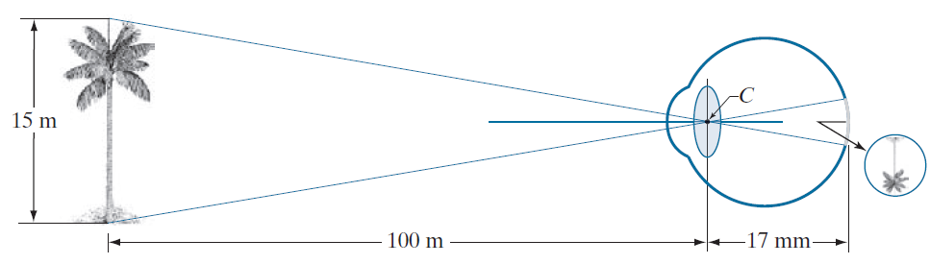
Module - 1 Digital Image Fundamentals
FIGURE 2.3 Graphical representation of the eye looking at a palm tree. Point C is the focal center of the lens.
Brightness Adaptation and Discrimination
Digital images are displayed as a discrete set of intensities
The eye’s ability to discriminate between different intensity levels is an important consideration in presenting image processing results
The range of light intensity levels to which the human visual system can adapt is enormous on the order of 10¹⁰
Experimental evidence indicates that subjective brightness (intensity as perceived by the human visual system) is a logarithmic function of the light intensity incident on the eye

Slide 51
Module - 1 Digital Image Fundamentals
Brightness Adaptation and Discrimination
Brightness Adaptation
The human visual sensory mechanisms adapt to different lighting conditions
The sensitivity level for a given lighting condition is called as the brightness adaptation level
As the lighting condition changes, our visual sensory mechanism will adapt by changing its sensitivity
The human eye cannot respond to the entire range of intensity levels at a given level of sensitivity
If we stand in a brightly lit area we cannot discern details in a dark area since it will appear totally dark.
Our photo-receptors cannot respond to the low level of intensity because the level of sensitivity has been adapted to the bright light
However a few minutes after moving into the dark room, our eyes would adapt to the required sensitivity level and we would be able to see in the dark area
This shows that though our visual system can respond to a wide dynamic range, it is possible only by adapting to different lighting conditions
At a given point of time our eye can respond well to only particular brightness levels
The response of the visual system can be characterized with respect to a particular brightness adaptation level

Slide 52
Module - 1 Digital Image Fundamentals
Image Sensing and Acquisition
Most images generated
“illumination” source + the reflection or absorption of energy from that source
Elements of the “scene” being imaged
Illumination may originate
Source of electromagnetic energy, such as a radar, infrared, or X-ray system
Less traditional sources, such as ultrasound or even a computer-generated illumination pattern
Scene elements
Familiar objects
Depending on the nature of the source, illumination energy is reflected from, or transmitted through, objects
An example in the first category
Light reflected from a planar surface
An example in the second category
When X-rays pass through a patient’s body for the purpose of generating a diagnostic X-ray image

Slide 53
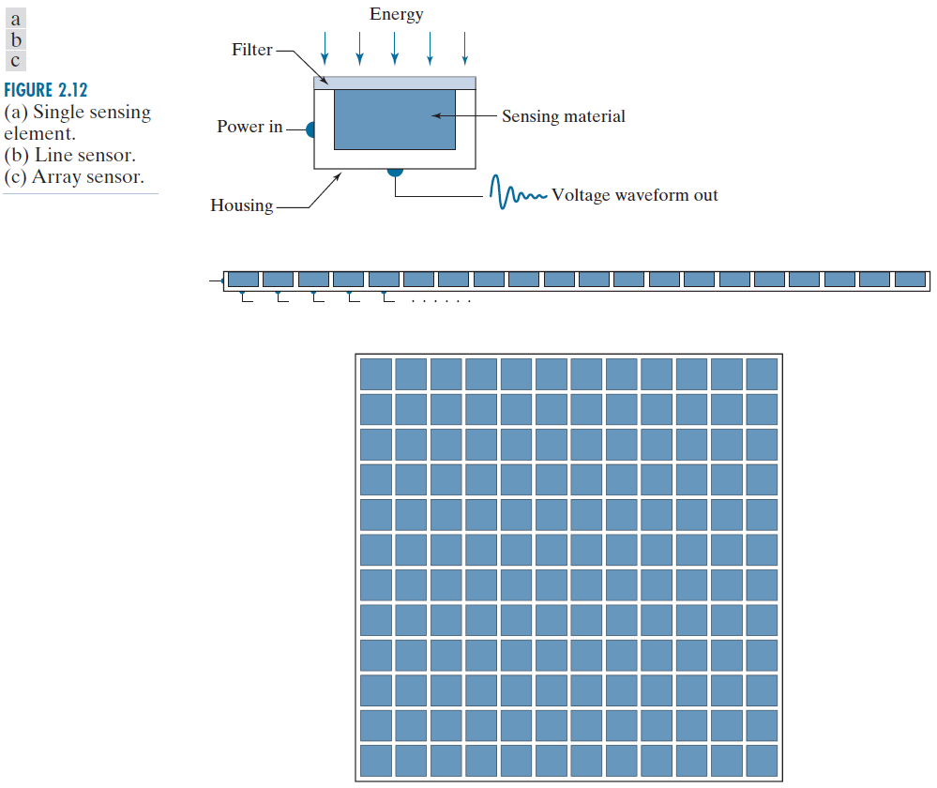
Module - 1 Digital Image Fundamentals

Slide 54
Module - 1 Digital Image Fundamentals
Image Sensing and Acquisition
Figure 2.12 shows the three principal sensor arrangements used to transform incident energy into digital images
Image Acquisition Using a Single Sensing Element
Image Acquisition Using Sensor Strips
Image Acquisition Using Sensor Arrays
The idea
Incoming energy is transformed into a voltage by a combination of the input electrical power and sensor material that is responsive to the type of energy being detected
The output voltage waveform is the response of the sensor
A digital quantity is obtained by digitizing that response

Slide 55
Module - 1 Digital Image Fundamentals
Image Sensing and Acquisition
Image Acquisition Using a Single Sensing Element
Figure 2.12(a) shows the components of a single sensing element
A familiar sensor of this type is the photodiode
Constructed of silicon materials
Output is a voltage proportional to light intensity
Using a filter in front of a sensor
Improves its selectivity
For example
An optical green-transmission filter favors light in the green band of the color spectrum
The sensor output would be stronger for green light than for other visible light components
To generate a 2-D image
There has to be relative displacements in both the x- and y-directions between the sensor and the area to be imaged
Figure 2.13 shows an arrangement used in high-precision scanning
A film negative is mounted onto a drum whose mechanical rotation provides displacement in one dimension
The sensor is mounted on a lead screw that provides motion in the perpendicular direction

Slide 56
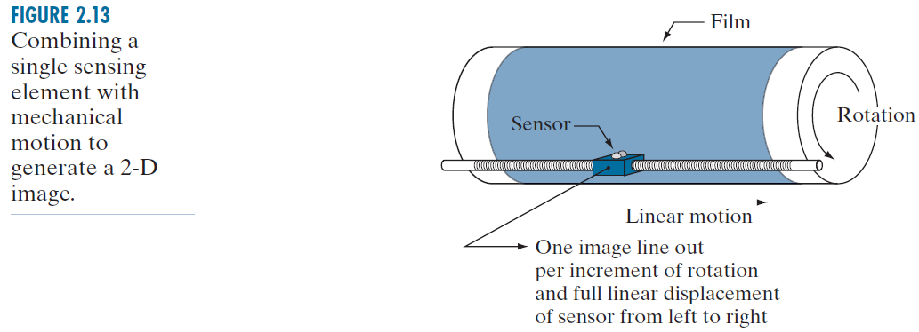
Module - 1 Digital Image Fundamentals
Image Sensing and Acquisition
Image Acquisition Using a Single Sensing Element
Figure 2.13
A light source is contained inside the drum
As the light passes through the film, its intensity is modified by the film density before it is captured by the sensor
This "modulation" of the light intensity causes corresponding variations in the sensor voltage, which are ultimately converted to image intensity levels by digitization

Slide 57
Module - 1 Digital Image Fundamentals
Image Sensing and Acquisition
Image Acquisition Using a Single Sensing Element
Advantage
Inexpensive way to obtain high-resolution images because mechanical motion can be controlled with high precision
Disadvantages
Slow
Not portable
Other similar mechanical arrangements use a flat imaging bed, with the sensor moving in two linear directions
These types of mechanical digitizers sometimes are referred to as transmission microdensitometers
Systems in which light is reflected from the medium, instead of passing through it, are called reflection microdensitometers
Another example of imaging with a single sensing element
Places a laser source coincident with the sensor
Moving mirrors are used to control the outgoing beam in a scanning pattern and to direct the reflected laser signal onto the sensor

Slide 58
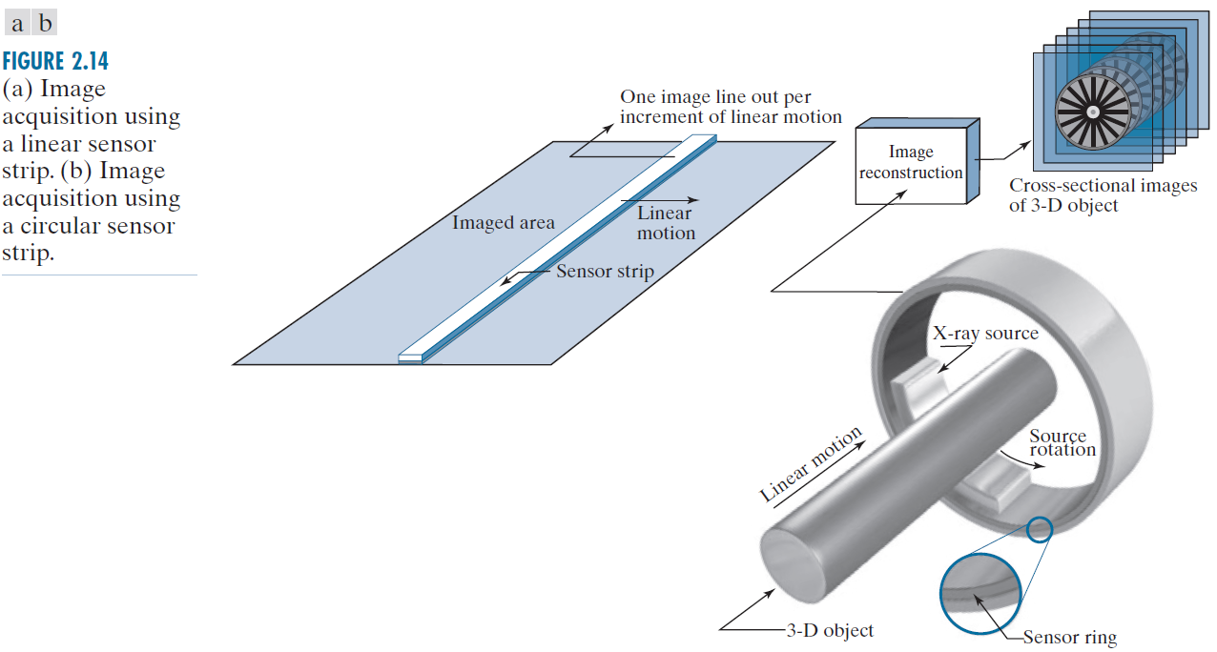
Module - 1 Digital Image Fundamentals

Slide 59
Module - 1 Digital Image Fundamentals
Image Sensing and Acquisition
Image Acquisition Using Sensor Strips
Fig. 2.12(b)
A geometry used more frequently
The strip provides imaging elements in one direction
Fig. 2.14(a)
Motion perpendicular to the strip provides imaging in the other direction
This arrangement is used in most flat bed scanners
Sensing devices with 4000 or more in-line sensors are possible
In-line sensors are used routinely in airborne imaging applications, in which the imaging system is mounted on an aircraft that flies at a constant altitude and speed over the geographical area to be imaged
One dimensional imaging sensor strips that respond to various bands of the electromagnetic spectrum are mounted perpendicular to the direction of flight
An imaging strip gives one line of an image at a time, and the motion of the strip relative to the scene completes the other dimension of a 2-D image
Lenses or other focusing schemes are used to project the area to be scanned onto the sensors

Slide 60
Module - 1 Digital Image Fundamentals
Image Sensing and Acquisition
Image Acquisition Using Sensor Strips
Fig. 2.14(b)
Sensor strips in a ring configuration are used in medical and industrial imaging to obtain cross-sectional (“slice”) images of 3-D objects
A rotating X-ray source provides illumination, and X-ray sensitive sensors opposite the source collect the energy that passes through the object
This is the basis for medical and industrial computerized axial tomography (CAT) imaging
The output of the sensors is processed by reconstruction algorithms whose objective is to transform the sensed data into meaningful cross sectional images
In other words, images are not obtained directly from the sensors by motion alone; they also require extensive computer processing
A 3-D digital volume consisting of stacked images is generated as the object is moved in a direction perpendicular to the sensor ring

Slide 61
Module - 1 Digital Image Fundamentals
Image Sensing and Acquisition
Image Acquisition Using Sensor Strips
Fig. 2.14(b)
Other modalities of imaging based on the CAT principle include magnetic resonance imaging (MRI) and positron emission tomography (PET)
The illumination sources, sensors, and types of images are different, but conceptually their applications are very similar to the basic imaging approach shown in Fig. 2.14(b).

Slide 62
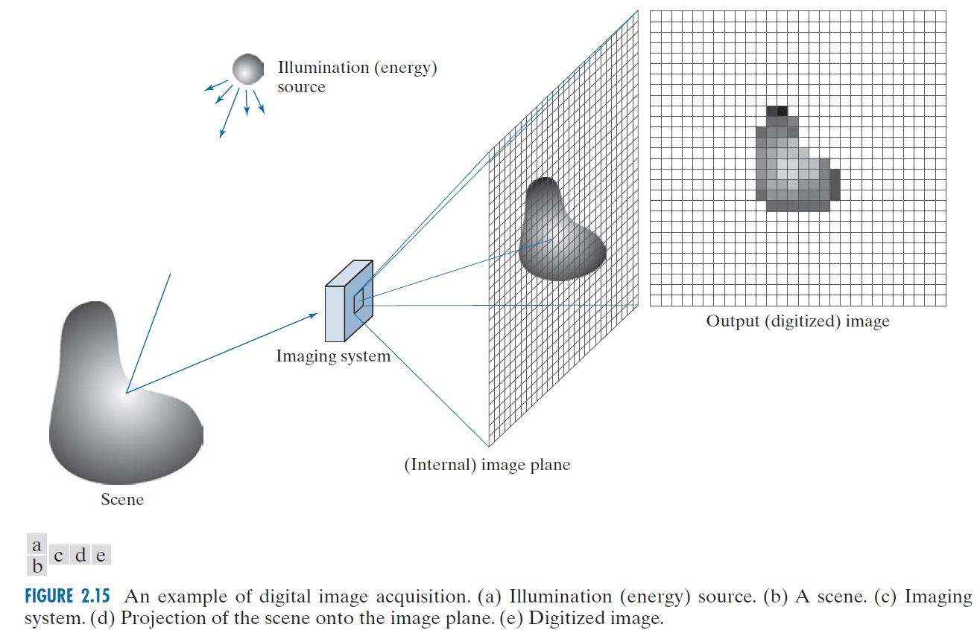
Module - 1 Digital Image Fundamentals

Slide 63
Module - 1 Digital Image Fundamentals
Image Sensing and Acquisition
Image Acquisition Using Sensor Arrays
Figure 2.12(c)
Shows individual sensing elements arranged in the form of a 2-D array
Electromagnetic and ultrasonic sensing devices frequently are arranged in this manner
The predominant arrangement found in digital cameras
A typical sensor for these cameras is a CCD (charge-coupled device) array, which can be manufactured with a broad range of sensing properties and can be packaged in rugged arrays of 4000 * 4000 elements or more
CCD sensors are used widely in digital cameras and other light-sensing instruments
The response of each sensor is proportional to the integral of the light energy projected onto the surface of the sensor, a property that is used in astronomical and other applications requiring low noise images
Noise reduction is achieved by letting the sensor integrate the input light signal over minutes or even hours
Its key advantage is that a complete image can be obtained by focusing the energy pattern onto the surface of the array

Slide 64
Module - 1 Digital Image Fundamentals
Image Sensing and Acquisition
Image Acquisition Using Sensor Arrays
Figure 2.15
Shows the principal manner in which array sensors are used
Shows the energy from an illumination source being reflected from a scene
The first function performed by the imaging system in Fig. 2.15(c) is to collect the incoming energy and focus it onto an image plane
If the illumination is light, the front end of the imaging system is an optical lens that projects the viewed scene onto the focal plane of the lens, as Fig. 2.15(d) shows
The sensor array, which is coincident with the focal plane, produces outputs proportional to the integral of the light received at each sensor
Digital and analog circuitry sweep these outputs and convert them to an analog signal, which is then digitized by another section of the imaging system
The output is a digital image, as shown diagrammatically in Fig. 2.15(e)

Slide 65
Module - 1 Digital Image Fundamentals
Image Sensing and Acquisition
A Simple Image Formation Model
we denote images by two-dimensional functions of the form f (x, y)
The value of f at spatial coordinates (x, y) is a scalar quantity whose physical meaning is determined by the source of the image, and whose values are proportional to energy radiated by a physical source (e.g., electromagnetic waves)
As a consequence, f (x, y) must be nonnegative and finite; that is, 0 ≤ f (x, y) < ∞
Function f (x, y) is characterized by two components
The amount of source illumination incident on the scene being viewed, called the illumination, denoted by i(x, y)
The amount of illumination reflected by the objects in the scene, called reflectance, denoted by r(x, y)
The two functions combine as a product to form f (x, y): f (x, y) = i(x, y)r(x, y), where 0 ≤ i(x, y) < ∞ and 0 ≤ r(x, y) ≤ 1

Slide 66
Module - 1 Digital Image Fundamentals
Image Sensing and Acquisition
A Simple Image Formation Model
Reflectance is bounded by 0 (total absorption) and 1 (total reflectance)
The nature of i(x, y) is determined by the illumination source, and r(x, y) is determined by the characteristics of the imaged objects
These expressions are applicable also to images formed via transmission of the illumination through a medium, such as a chest X-ray
In this case, we would deal with a transmissivity instead of a reflectivity function, but the limits would be the same as in Eq. , and the image function formed would be modeled as the product in Eq.
EXAMPLE 2.1
Some typical values of illumination and reflectance
The following numerical quantities illustrate some typical values of illumination and reflectance for visible light
On a clear day, the sun may produce in excess of 90,000 lm/m² of illumination on the surface of the earth
This value decreases to less than 10,000 lm/m² on a cloudy day

Slide 67
Module - 1 Digital Image Fundamentals
Image Sensing and Acquisition
A Simple Image Formation Model
EXAMPLE 2.1
On a clear evening, a full moon yields about 0.1 lm/m² of illumination
The typical illumination level in a commercial office is about 1,000 lm/m²
Similarly, the following are typical values of r(x, y): 0.01 for black velvet, 0.65 for stainless steel, 0.80 for flat-white wall paint, 0.90 for silver-plated metal, and 0.93 for snow
Let the intensity (gray level) of a monochrome image at any coordinates (x, y) be denoted by l = f (x, y)
From Eqs. it is evident that l lies in the range L_{min} ≤ l ≤ L_{max}
In theory, the requirement on L_{min} is that it be nonnegative, and on L_{max} that i be finite.
In practice, L_{min} = i_{min} r_{min} and L_{max} = i_{max} r_{max}
From Example 2.1, using average office illumination and reflectance values as guidelines, we may expect L_{min} ≈ 10 and L_{max} ≈ 1000 to be typical indoor values in the absence of additional illumination

Slide 68
Module - 1 Digital Image Fundamentals
Image Sensing and Acquisition
A Simple Image Formation Model
The units of these quantities are lum/m²
However, actual units seldom are of interest, except in cases where photometric measurements are being performed
The interval [L_{min} ,L_{max} ] is called the intensity (or gray) scale
Common practice is to shift this interval numerically to the interval [0, 1], or [0, C], where l = 0 is considered black and l = 1 (or C) is considered white on the scale
All intermediate values are shades of gray varying from black to white

Slide 69
Module - 1 Digital Image Fundamentals
Image Sampling and Quantization
Done
To generate digital images from sensed data
The output of most sensors is a continuous voltage waveform whose amplitude and spatial behavior are related to the physical phenomenon being sensed
Sampling and Quantization
To create a digital image, we need to convert the continuous sensed data into a digital format
Basic Concepts
Figure 2.16(a) shows a continuous image f that we want to convert to digital form
An image may be continuous with respect to the x- and y-coordinates, and also in amplitude
To digitize it, we have to sample the function in both coordinates and also in amplitude
Sampling
Digitizing the coordinate values
Quantization
Digitizing the amplitude values

Slide 70
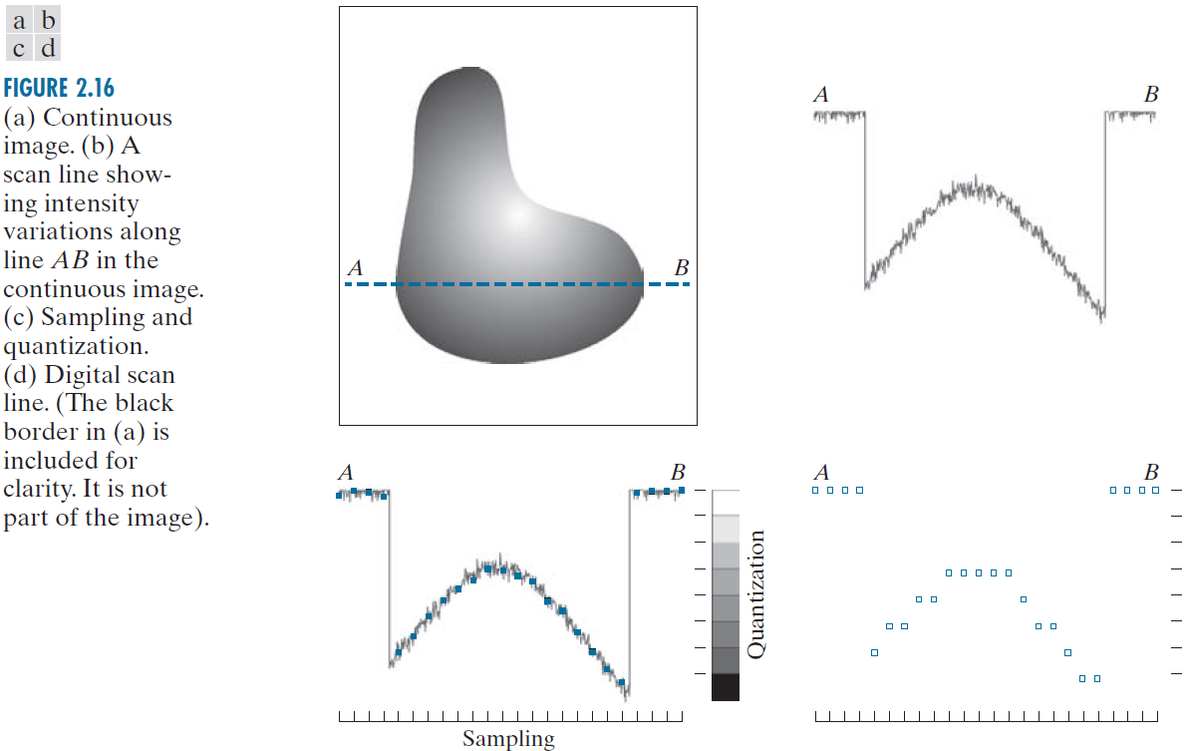
Module - 1 Digital Image Fundamentals

Slide 71
Module - 1 Digital Image Fundamentals
Image Sampling and Quantization
Basic Concepts
Fig. 2.16(b)
The one-dimensional function is a plot of amplitude (intensity level) values of the continuous image along the line segment AB in Fig. 2.16(a).
The random variations are due to image noise
Fig. 2.16(c)
To sample this function, we take equally spaced samples along line AB
The samples are shown as small dark squares superimposed on the function, and their (discrete) spatial locations are indicated by corresponding tick marks in the bottom of the figure
The set of dark squares constitute the sampled function
The values of the samples still span (vertically) a continuous range of intensity values
In order to form a digital function, the intensity values also must be converted (quantized) into discrete quantities

Slide 72
Module - 1 Digital Image Fundamentals
Image Sampling and Quantization
Basic Concepts
Fig. 2.16(c)
The vertical gray bar depicts the intensity scale divided into eight discrete intervals, ranging from black to white
The vertical tick marks indicate the specific value assigned to each of the eight intensity intervals
The continuous intensity levels are quantized by assigning one of the eight values to each sample, depending on the vertical proximity of a sample to a vertical tick mark
Fig. 2.16(d)
The digital samples resulting from both sampling and quantization are shown as white squares
Starting at the top of the continuous image and carrying out this procedure downward, line by line, produces a two-dimensional digital image
It is implied in Fig. 2.16 that, in addition to the number of discrete levels used, the accuracy achieved in quantization is highly dependent on the noise content of the sampled signal

Slide 73
Module - 1 Digital Image Fundamentals
Image Sampling and Quantization
Method of sampling
Determined by the sensor arrangement used to generate the image
When an image is generated by a single sensing element combined with mechanical motion
The output of the sensor is quantized in the manner described above
When a sensing strip is used for image acquisition,
The number of sensors in the strip establishes the samples in the resulting image in one direction
Mechanical motion establishes the number of samples in the other
Quantization of the sensor outputs completes the process of generating a digital image
When a sensing array is used for image acquisition
No motion is required
The number of sensors in the array establishes the limits of sampling in both directions
Quantization of the sensor outputs is as explained above
Figure 2.17 illustrates this concept
Figure 2.17(a) shows a continuous image projected onto the plane of a 2-D sensor
Figure 2.17(b) shows the image after sampling and quantization

Slide 74
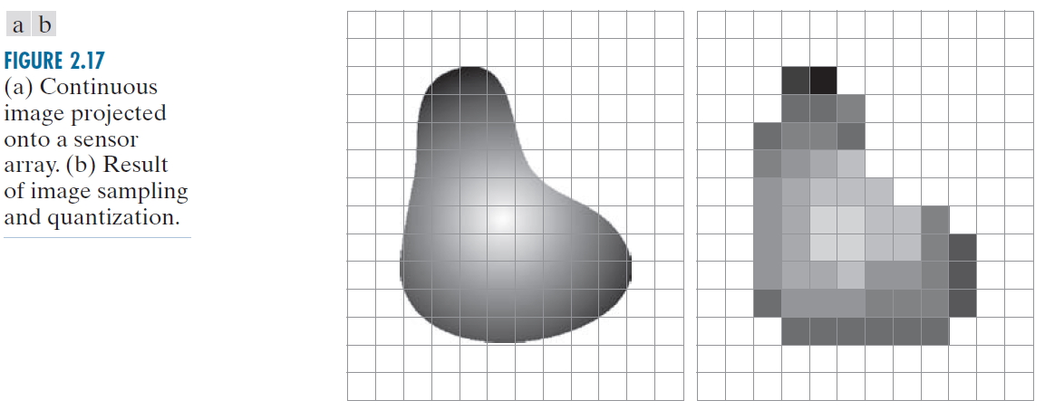
Module - 1 Digital Image Fundamentals

Slide 75
Module - 1 Digital Image Fundamentals
Representing Digital Images
Let f (s, t) represent a continuous image function of two continuous variables, s and t
Convert this function into a digital image by sampling and quantization
Suppose that we sample the continuous image into a digital image, f (x, y)
Containing M rows and N columns
Where (x, y) are discrete coordinates
x = 0, 1, 2,…,M − 1 and y = 0, 1, 2,…, N − 1
for example, the value of the digital image at the origin is f (0,0)
its value at the next coordinates along the first row is f (0,1)
The notation (0, 1) is used to denote the second sample along the first row
Does not the values of the physical coordinates
In general, the value of a digital image at any coordinates (x, y) is denoted f (x, y), where x and y are integers
When we need to refer to specific coordinates (i, j), we use the notation f (i, j), where the arguments are integers

Slide 76
Module - 1 Digital Image Fundamentals
Representing Digital Images
Spatial Domain
The section of the real plane spanned by the coordinates of an image
With x and y being referred to as spatial variables or spatial coordinates
Figure 2.18
Shows three ways of representing f (x, y)
Figure 2.18(a)
A plot of the function
Two axes determining spatial location
The third axis being the values of f as a function of x and y
This representation is useful when working with grayscale sets
Elements are expressed as triplets of the form (x, y,z)
Where x and y are spatial coordinates and z is the value of f at coordinates (x, y)
Figure 2.18(b)
Shows f (x, y) as it would appear on a computer display or photograph
Intensity of each point in the display is proportional to the value of f at that point

Slide 77
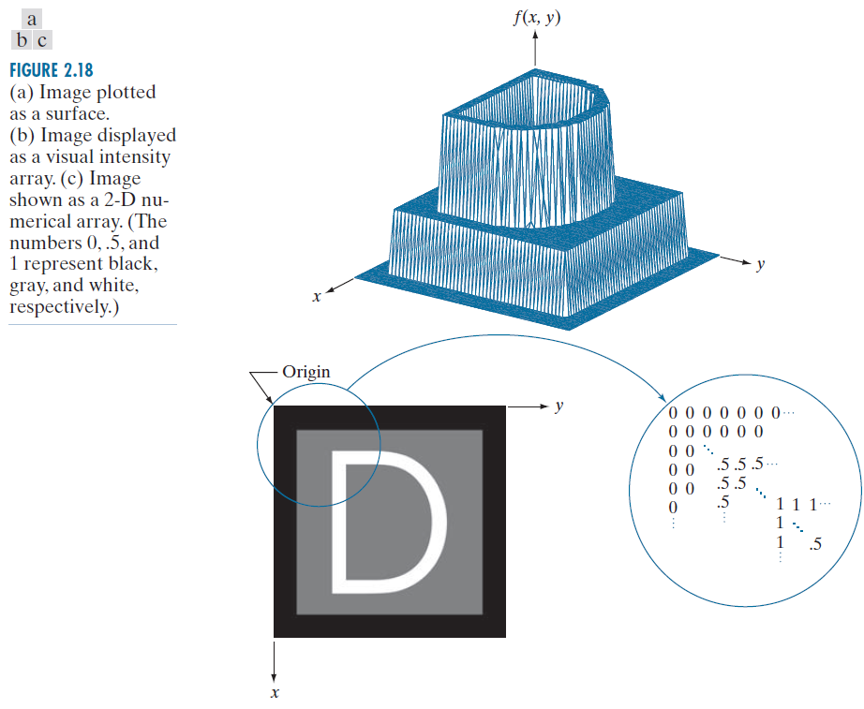
Module - 1 Digital Image Fundamentals

Slide 78
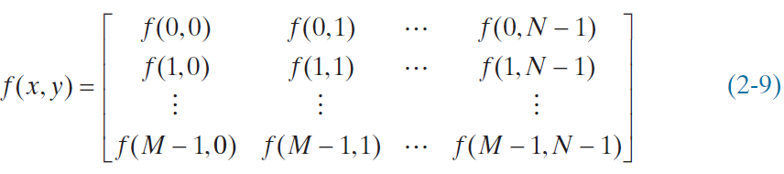
Module - 1 Digital Image Fundamentals
Representing Digital Images
Figure 2.18(b)
Only three equally spaced intensity values
If the intensity is normalized to the interval [0,1]
Each point in the image has the value 0, 0.5, or 1
A monitor or printer converts these three values to black, gray, or white, respectively
This type of representation includes color images, and allows us to view results at a glance
Figure 2.18(c)
Shows, the third representation is an array (matrix) composed of the numerical values of f (x, y)
Representation used for computer processing
In equation form, we write the representation of an M * N numerical array as

Slide 79
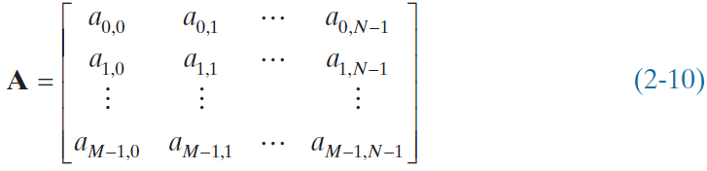
Module - 1 Digital Image Fundamentals
Representing Digital Images
Figure 2.18(c)
The right side of this equation is a digital image represented as an array of real numbers
Each element of this array is called an image element, picture element, pixel, or pel
We use the terms image and pixel throughout the book to denote a digital image and its elements
Figure 2.19
Shows a graphical representation of an image array,
Where the x- and y-axis are used to denote the rows and columns of the array
Specific pixels are values of the array at a fixed pair of coordinates
Generally use f (i, j) when referring to a pixel with coordinates (i, j)
Represent a digital image in a traditional matrix form:

Slide 80
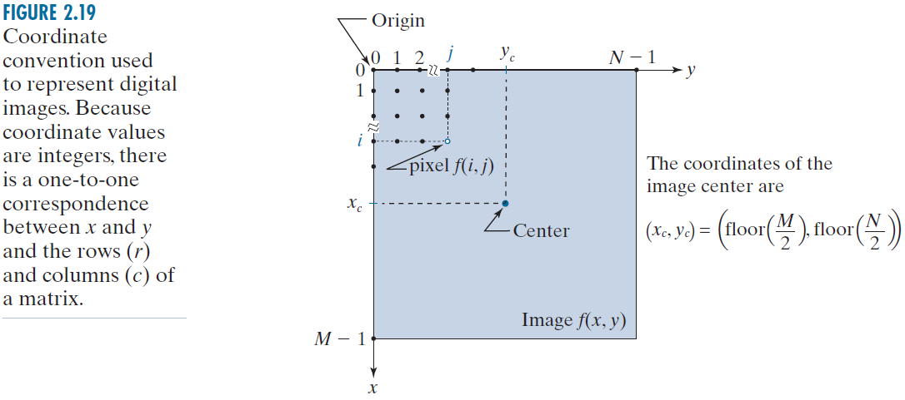
Module - 1 Digital Image Fundamentals

Slide 81
Module - 1 Digital Image Fundamentals
Representing Digital Images
Figure 2.19
Clearly, a_{i, j} = f (i , j ), so Eqs. (2-9) and (2-10) denote identical arrays
Define the origin of an image at the top left corner
This is a convention based on the fact that many image displays (e.g., TV monitors) sweep an image starting at the top left and moving to the right, one row at a time
The fact that the first element of a matrix is by convention at the top left of the array
Choosing the origin of f (x, y) at that point makes sense mathematically because digital images in reality are matrices
In fact,sometimes we use x and y interchangeably in equations with the rows (r) and columns (c) of a matrix
The positive x-axis extends downward and the positive y-axis extends to the right, is precisely the right-handed Cartesian coordinate system with which you are familiar, but shown rotated by 90° so that the origin appears on the top, left

Slide 82
Module - 1 Digital Image Fundamentals
Representing Digital Images
Figure 2.19
An M × N digital image with origin at (0,0)
Range to (M − 1,N − 1)
Center is obtained by dividing M and N by 2 and rounding down to the nearest integer
This operation sometimes is denoted using the floor operator
This holds true for M and N even or odd
For example, the center of an image of size 1023 × 1024 is at (511, 512)
Some programming languages (e.g., MATLAB) start indexing at 1 instead of at 0
The center of an image in that case is found at (x_{c} , y_{c}) = (floor(M/2) + 1 , floor(N/2) + 1)
To express sampling and quantization in more formal mathematical terms
let Z = the set of integers and R = the set of real numbers
The sampling process may be viewed as partitioning the xy-plane into a grid

Slide 83
Module - 1 Digital Image Fundamentals
Representing Digital Images
To express sampling and quantization in more formal mathematical terms
The coordinates of the center of each cell in the grid being a pair of elements from the Cartesian product Z² (also denoted Z × Z) which, as you may recall, is the set of all ordered pairs of elements (z_{i} ,z_{j} ) with z_{i} and z_{j} being integers from set
Hence, f (x, y) is a digital image if (x, y) are integers from Z² and f is a function that assigns an intensity value (that is, a real number from the set of real numbers, R) to each distinct pair of coordinates (x, y)
This functional assignment is the quantization process
If the intensity levels also are integers, then R = Z, and a digital image becomes a 2-D function whose coordinates and amplitude values are integers
Image digitization requires that decisions be made regarding the values for M, N, and for the number, L, of discrete intensity levels

Slide 84
Module - 1 Digital Image Fundamentals
Representing Digital Images
There are no restrictions placed on M and N, other than they have to be positive integers
However, digital storage and quantizing hardware considerations usually lead to the number of intensity levels, L, being an integer power of two; that is L = 2^{k} where k is an integer
We assume that the discrete levels are equally spaced and that they are integers in the range [0,L − 1]
Sometimes, the range of values spanned by the gray scale is referred to as the dynamic range, a term used in different ways in different fields
The dynamic range of an imaging system to be the ratio of the maximum measurable intensity to the minimum detectable intensity level in the system
As a rule, the upper limit is determined by saturation and the lower limit by noise, although noise can be present also in lighter intensities

Slide 85
Module - 1 Digital Image Fundamentals
Representing Digital Images
Figure 2.20 shows examples of saturation and slight visible noise
Because the darker regions are composed primarily of pixels with the minimum detectable intensity, the background in Fig. 2.20 is the noisiest part of the image; however, dark background noise typically is much harder to see
The dynamic range establishes the lowest and highest intensity levels that a system can represent and, consequently, that an image can have
Closely associated with this concept is image contrast, which we define as the difference in intensity between the highest and lowest intensity levels in an image
The contrast ratio is the ratio of these two quantities
When an appreciable number of pixels in an image have a high dynamic range, we can expect the image to have high contrast
Conversely, an image with low dynamic range typically has a dull, washed-out gray look

Slide 86
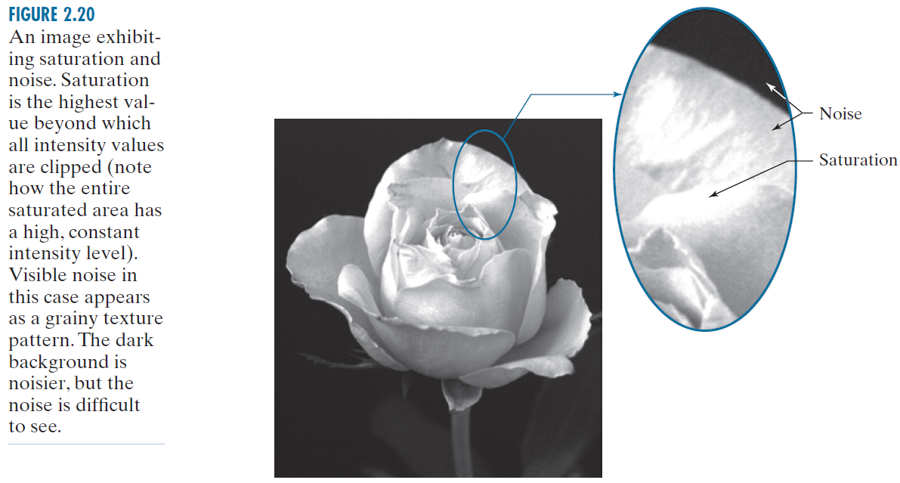
Module - 1 Digital Image Fundamentals

Slide 87
Module - 1 Digital Image Fundamentals
Representing Digital Images
The number, b, of bits required to store a digital image is b = M * N * k
When M = N, this equation becomes b = N² k
Figure 2.21 shows the number of megabytes required to store square images for various values of N and k (as usual, one byte equals 8 bits and a megabyte equals 10⁶ bytes)
When an image can have 2^{k} possible intensity levels, it is common practice to refer to it as a “k-bit image,” (e,g., a 256-level image is called an 8-bit image)

Slide 88
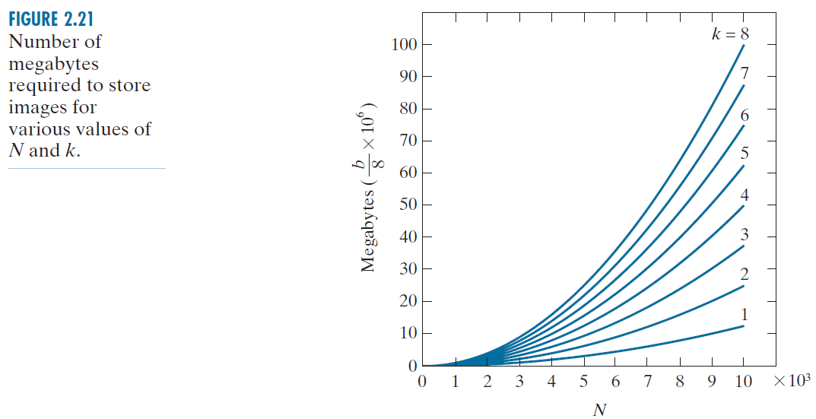
Module - 1 Digital Image Fundamentals

Slide 89
Module - 1 Digital Image Fundamentals
Some Basic Relationships Between Pixels
Relationships between pixels in a digital image
Use lowercase letters, such as p and q
Neighbours of a Pixel
A pixel p at coordinates (x, y) has two horizontal and two vertical neighbors with coordinates
(x + 1, y), (x − 1, y), (x, y + 1), (x, y − 1)
This set of pixels, called the 4-neighbors of p, is denoted N₄(p)
The four diagonal neighbors of p have coordinates
(x + 1, y + 1), (x + 1, y − 1), (x − 1, y + 1), (x − 1, y − 1)
and are denoted N_{D}(p)
These neighbors, together with the 4-neighbors, are called the 8-neighbors of p, denoted by N₈(p)

Slide 90
Module - 1 Digital Image Fundamentals
Some Basic Relationships Between Pixels
The set of image locations of the neighbors of a point p is called the neighborhood of p
The neighborhood is said to be closed if it contains p
Otherwise, the neighborhood is said to be open
Adjacency, Connectivity, Regions, and Boundaries
Let V be the set of intensity values used to define adjacency
In a binary image, V = {1} if we are referring to adjacency of pixels with value 1
In a grayscale image, set V typically contains more elements, dealing with the adjacency of pixels whose values are in the range 0 to 255, set V could be any subset of these 256 values
We consider three types of adjacency:

Slide 91
Module - 1 Digital Image Fundamentals
Some Basic Relationships Between Pixels
Adjacency
4-adjacency
Two pixels p and q with values from V are 4-adjacent if q is in the set N₄(p)
8-adjacency
Two pixels p and q with values from V are 8-adjacent if q is in the set N₈(p)
m-adjacency (also called mixed adjacency)
Two pixels p and q with values from V are m-adjacent if
q is in N₄(p), or
q is in N_{D}(p) and the set N₄(p) ∩ N₄(q) has no pixels whose values are from V
For example, consider the pixel arrangement in Fig. 2.28(a) and let V = {1}
The three pixels at the top of Fig. 2.28(b) show multiple (ambiguous) 8-adjacency, as indicated by the dashed lines
This ambiguity is removed by using m-adjacency, as in Fig. 2.28(c)

Slide 92
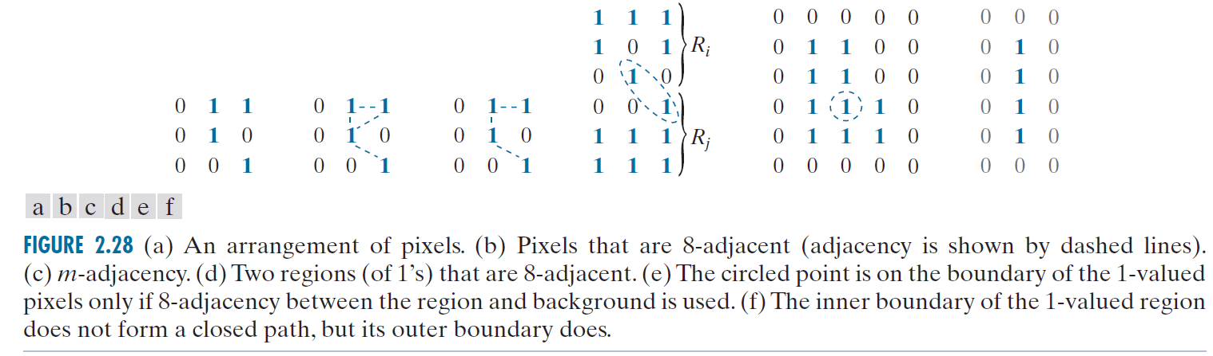
Module - 1 Digital Image Fundamentals

Slide 93
Module - 1 Digital Image Fundamentals
Some Basic Relationships Between Pixels
Connectivity
A digital path (or curve) from pixel p with coordinates (x_{o} , y_{o} ) to pixel q with coordinates (x_{n} , y_{n} ) is a sequence of distinct pixels with coordinates
(x_{o} , y_{o} ), (x₁ , y₁ ),… (x_{n} , y_{n} )
where points (x_{i} , y_{i} ) and (x_{i-1} , y_{i-1} ) are adjacent for 1 ≤ i ≤ n
n is the length of the path
If(x_{o} , y_{o} ) = (x_{n} , y_{n} ) the path is a closed path
We can define 4-, 8-, or m-paths, depending on the type of adjacency specified
For example, the paths in Fig. 2.28(b) between the top right and bottom right points are 8-paths, and the path in Fig. 2.28(c) is an m-path

Slide 94
Module - 1 Digital Image Fundamentals
Some Basic Relationships Between Pixels
Connectivity
Let S represent a subset of pixels in an image
Two pixels p and q are said to be connected in S if there exists a path between them consisting entirely of pixels in S
For any pixel p in S, the set of pixels that are connected to it in S is called a connected component of S
If it only has one component, and that component is connected, then S is called a connected set
Regions
Let R represent a subset of pixels in an image
We call R a region of the image if R is a connected set
Two regions, R_{i} and R_{j} are said to be adjacent if their union forms a connected set
Regions that are not adjacent are said to be disjoint
We consider 4- and 8-adjacency when referring to regions

Slide 95
Module - 1 Digital Image Fundamentals
Some Basic Relationships Between Pixels
Regions
The type of adjacency used must be specified
For example, the two regions of 1’s in Fig. 2.28(d) are adjacent only if 8-adjacency is used
Suppose an image contains K disjoint regions, R_{k} , k =1, 2,…, K, none of which touches the image border
Let R_{u} denote the union of all the K regions, and let (R_{u} )^{c} denote its complement
We call all the points in R_{u} the foreground, and all the points in (R_{u} )^{c} the background of the image
Boundaries
The boundary (also called the border or contour) of a region R is the set of pixels in R that are adjacent to pixels in the complement of R
Stated another way, the border of a region is the set of pixels in the region that have at least one background neighbor

Slide 96
Module - 1 Digital Image Fundamentals
Some Basic Relationships Between Pixels
Boundaries
We must specify the connectivity being used to define adjacency
For example, the point circled in Fig. 2.28(e) is not a member of the border of the 1-valued region if 4-connectivity is used between the region and its background, because the only possible connection between that point and the background is diagonal
As a rule, adjacency between points in a region and its background is defined using 8-connectivity to handle situations such as this
The preceding definition sometimes is referred to as the inner border of the region to distinguish it from its outer border, which is the corresponding border in the background
This distinction is important in the development of border-following algorithms

Slide 97
Module - 1 Digital Image Fundamentals
Some Basic Relationships Between Pixels
Boundaries
Such algorithms usually are formulated to follow the outer boundary in order to guarantee that the result will form a closed path
For instance, the inner border of the 1-valued region in Fig. 2.28(f) is the region itself
This border does not satisfy the definition of a closed path
On the other hand, the outer border of the region does form a closed path around the region
If R happens to be an entire image, then its boundary (or border) is defined as the set of pixels in the first and last rows and columns of the image
This extra definition is required because an image has no neighbors beyond its border
Normally, when we refer to a region, we are referring to a subset of an image, and any pixels in the boundary of the region that happen to coincide with the border of the image are included implicitly as part of the region boundary

Slide 98
Module - 1 Digital Image Fundamentals
Some Basic Relationships Between Pixels
Boundaries
The boundary of a finite region forms a closed path and is thus a “global” concept
Edges are formed from pixels with derivative values that exceed a preset threshold
Thus, an edge is a “local” concept that is based on a measure of intensity-level discontinuity at a point
It is possible to link edge points into edge segments, and sometimes these segments are linked in such a way that they correspond to boundaries, but this is not always the case
Distance Measures
For pixels p, q, and s, with coordinates (x, y), (u,v), and (w,z), respectively, D is a distance function or metric if

Slide 99
Module - 1 Digital Image Fundamentals
Some Basic Relationships Between Pixels
Distance Measures
For pixels p, q, and s, with coordinates (x, y), (u,v), and (w,z), respectively, D is a distance function or metric if
D(p,q) ≥ 0 (D(p,q) = 0 iff p = q) ,
D(p,q) = D(q, p), and
D(p, s) ≤ D(p, q) + D(q, s).
The Euclidean distance between p and q is defined as
D_{e} (p, q) = [(x - u)² + (y - v)²]^{½}
The pixels having a distance less than or equal to some value r from (x, y) are the points contained in a disk of radius r centered at (x, y)
The D4 distance, (called the city-block distance) between p and q is defined as
D₄ (p, q) = ⎸(x - u) ⎸+ ⎸(y - v) ⎸

Slide 100
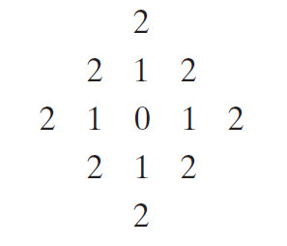
Module - 1 Digital Image Fundamentals
Some Basic Relationships Between Pixels
Distance Measures
Pixels having a D₄ distance from (x, y) that is less than or equal to some value d form a diamond centered at (x, y)
For example, the pixels with D₄ distance ≤ 2 from (x, y) (the center point) form the following contours of constant distance:

Slide 101
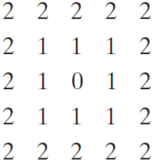
Module - 1 Digital Image Fundamentals
Some Basic Relationships Between Pixels
Distance Measures
The pixels with D₄ = 1 are the 4-neighbors of (x, y).
The D₈ distance (called the chessboard distance) between p and q is defined as
D₈ (p, q) = max( ⎸(x - u) ⎸, ⎸(y - v) ⎸)
The pixels with D₈ distance from (x, y) less than or equal to some value d form a square centered at (x, y)
For example, the pixels with D₈ distance ≤ 2 form the following contours of constant distance:

Slide 102
Module - 1 Digital Image Fundamentals
Some Basic Relationships Between Pixels
Distance Measures
The pixels with D₈ = 1 are the 8-neighbors of the pixel at (x, y)
Note that the D₄ and D₈ distances between p and q are independent of any paths that might exist between these points because these distances involve only the coordinates of the points
In the case of m-adjacency, however, the D_{m} distance between two points is defined as the shortest m-path between the points
In this case, the distance between two pixels will depend on the values of the pixels along the path, as well as the values of their neighbors
For instance, consider the following arrangement of pixels and assume that p, p₂ , and p₄ have a value of 1, and that p₁ and p₃ can be 0 or 1:

Slide 103
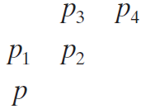
Module - 1 Digital Image Fundamentals
Some Basic Relationships Between Pixels
Distance Measures
Suppose that we consider adjacency of pixels valued 1 (i.e.,V = {1}). If p₁ and p₃are 0, the length of the shortest m-path (the D_{m} distance) between p and p₄ is 2
If p₁ is 1, then p₂ and p will no longer be m-adjacent and the length of the shortest m-path becomes 3 (the path goes through the points pp₁p₂p₄)
Similar comments apply if p₃ is 1 (and p₁ is 0);
In this case, the length of the shortest m-path also is 3
Finally, if both p₁ and p₃ are 1, the length of the shortest m-path between p and p₄ is 4
In this case, the path goes through the sequence of points pp₁p₂p₃p₄

Slide 104
Module - 1 Digital Image Fundamentals
Color Image Processing
Color in Image Processing
Color is a powerful descriptor that often simplifies object identification and extraction from a scene
Humans can detect thousands of color shades, compared to only two dozen shades of gray
Divided into two major areas
Pseudo-Color Processing
Assigning color(s) to a particular grayscale intensity or range of intensities
Full-Color Processing
Images are acquired using a full-color sensor, such as a digital camera, or color scanner
Color Fundamentals
In 1666, Sir Isaac Newton discovered
When a beam of sunlight passes through a glass prism
The emerging light is not white
Consists a continuous spectrum of colors ranging from violet at one end to red at the other

Slide 105
Module - 1 Digital Image Fundamentals
Color Image Processing
Color Fundamentals
In 1666, Sir Isaac Newton discovered
In Fig. 6.1, the color spectrum may be divided into six regions: violet, blue, green, yellow, orange, and red
The colors that humans and some other animals perceive in an object
Determined by the nature of the light reflected from the object
In Fig. 6.2, visible light is composed of a relatively narrow band of frequencies in the electromagnetic spectrum
A body that reflects light that is balanced in all visible wavelengths appears white to the observer
A body that favors reflectance in a limited range of the visible spectrum exhibits some shades of color

Slide 106
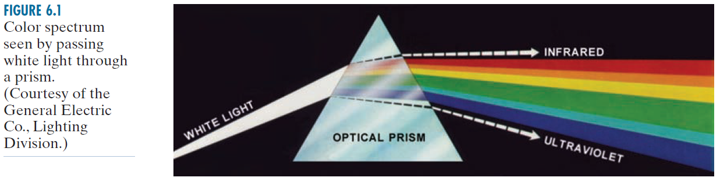
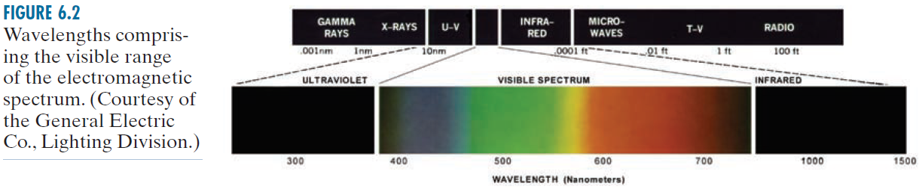
Module - 1 Digital Image Fundamentals

Slide 107
Module - 1 Digital Image Fundamentals
Color Image Processing
Color Fundamentals
Science of Color
Characterization of light
Achromatic Light (without color)
Only attribute is its intensity, or amount
Gray (or intensity) level
A scalar measure of intensity that ranges from black, to grays, and finally to white
What you see on movie films made before the 1930s
Chromatic Light
Spans the electromagnetic spectrum from approximately 400 to 700 nm
Describe the quality of a chromatic light source
Radiance
Luminance
Brightness
Radiance
Total amount of energy that flows from the light source
Measured in watts (W)

Slide 108
Module - 1 Digital Image Fundamentals
Color Image Processing
Color Fundamentals
Chromatic Light
Luminance
Measure of the amount of energy that an observer perceives from a light source
Measured in lumens (lm)
Brightness
Subjective descriptor that is practically impossible to measure
Embodies the achromatic notion of intensity
Describing color sensation
Cones
The sensors in the eye responsible for color vision
6 to 7 million cones in the human eye
Divided into three principal sensing categories
Red, Green, and Blue
Approximately 65% of all cones are sensitive to red light
33% are sensitive to green light
Only about 2% are sensitive to blue
The blue cones are the most sensitive

Slide 109
Module - 1 Digital Image Fundamentals
Color Image Processing
Color Fundamentals
Figure 6.3 shows
Average experimental curves
Absorption of light by the red, green, and blue cones in the eye
The human eye sees colors as variable combinations of Red (R), Green (G), and Blue (B)
Called Primary Colors
As per the CIE (Commission Internationale del’ Eclairage—the International Commission on Illumination) standardization following specific wavelength values to the three primary colors
Blue = 435.8 nm
Green = 546.1 nm
Red = 700 nm
Secondary Colors of light
The primary colors can be added together
Magenta = Red + Blue
Cyan = Green + Blue
Yellow = Red + Green

Slide 110
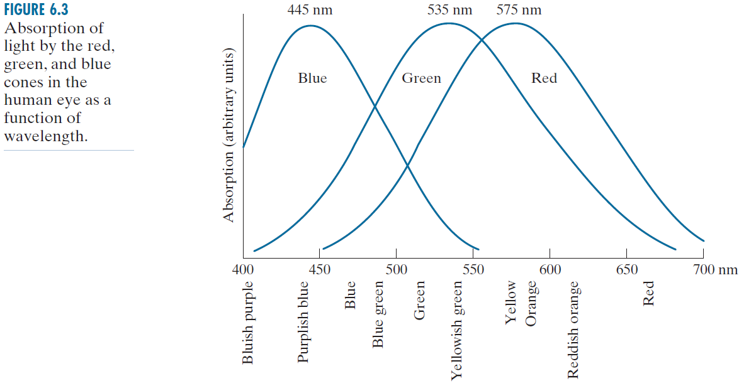
Module - 1 Digital Image Fundamentals

Slide 111
Module - 1 Digital Image Fundamentals
Color Image Processing
Color Fundamentals
Secondary Colors of light
Mixing the three primaries, or a secondary with its opposite primary color, in the right intensities produces white light
Fig. 6.4(a) shows the three primary colors and their combinations to produce the secondary colors of light
The primary colors of pigments or colorants
A primary color is defined as one that subtracts or absorbs a primary color of light, and reflects or transmits the other two
The primary colors of pigments are magenta, cyan, and yellow, and the secondary colors are red, green, and blue
These colors are shown in Fig. 6.4(b)
A proper combination of the three pigment primaries, or a secondary with its opposite primary, produces black

Slide 112
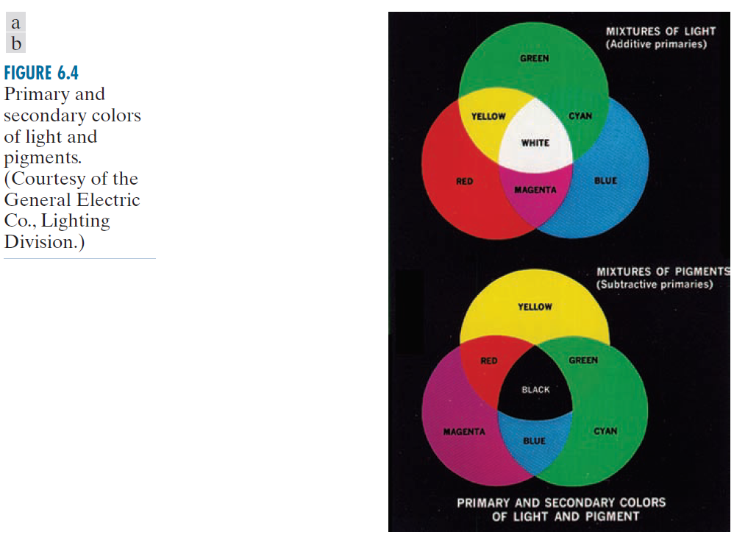
Module - 1 Digital Image Fundamentals

Slide 113
Module - 1 Digital Image Fundamentals
Color Image Processing
Color Fundamentals
Characteristics used to distinguish one color from another are brightness, hue, and saturation
Brightness
Embodies the achromatic notion of intensity
Hue
Represents dominant color as perceived by an observer
When we call an object red, orange, or yellow, we are referring to its hue
Saturation
Refers to the relative purity or the amount of white light mixed with a hue
The pure spectrum colors are fully saturated
Colors such as pink (red and white) and lavender (violet and white) are less saturated
The degree of saturation being inversely proportional to the amount of white light added

Slide 114
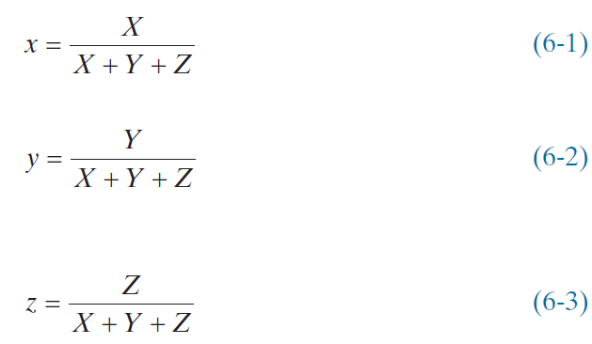
Module - 1 Digital Image Fundamentals
Color Image Processing
Color Fundamentals
Chromaticity
Hue and saturation taken together
A color may be characterized by its brightness and chromaticity
Tristimulus values
The amounts of red, green, and blue needed to form any particular color
Denoted, X, Y, and Z, respectively
Trichromatic Coefficients
Specified a color and defined as

Slide 115
Module - 1 Digital Image Fundamentals
Color Image Processing
Color Fundamentals
Trichromatic Coefficients
CIE Chromaticity Diagram
Another approach for specifying colors
Fig. 6.5
Shows color composition as a function of x (red) and y (green)
For any value of x and y
The corresponding value of z (blue) is obtained from Eq. (6-4) by noting that z = 1 − (x + y)
The point marked green in Fig. 6.5
Approximately 62% green
25% red content
from Eq. (6-4) that the composition of blue is approximately 13%
The positions of the various spectrum colors
from violet at 380 nm to red at 780 nm
Indicated around the boundary of the tongue-shaped chromaticity diagram.

Slide 116
Module - 1 Digital Image Fundamentals
Color Image Processing
Color Fundamentals
CIE Chromaticity Diagram
These are the pure colors shown in the spectrum of Fig. 6.2
Any point not actually on the boundary, but within the diagram
Represents some mixture of the pure spectrum colors
The point of equal energy shown in Fig. 6.5
Corresponds to equal fractions of the three primary colors
Represents the CIE standard for white light
Any point located on the boundary of the chromaticity chart
Fully saturated
As a point leaves the boundary and approaches the point of equal energy
More white light is added to the color
Becomes less saturated
The saturation at the point of equal energy
Zero

Slide 117
Module - 1 Digital Image Fundamentals
Color Image Processing
Color Fundamentals
CIE Chromaticity Diagram
Useful for color mixing
Straight-line segment joining any two points
Defines all the different color variations
Obtained by combining these two colors additively
Consider, for example, a straight line drawn from the red to the green points shown in Fig. 6.5
If there is more red than green light
The exact point representing the new color will be on the line segment
Closer to the red point than to the green point
A line drawn from the point of equal energy to any point on the boundary
Define all the shades of that particular spectrum color
To determine the range of colors that can be obtained from any three given colors
Simply draw connecting lines to each of the three color points
The result is a triangle
Any color inside the triangle, or on its boundary, can be produced by various combinations of the three vertex colors

Slide 118
Module - 1 Digital Image Fundamentals
Color Image Processing
Color Fundamentals
CIE Chromaticity Diagram
A triangle with vertices at any three fixed colors
Cannot enclose the entire color region in Fig. 6.5
Not all colors can be obtained with three single, fixed primaries, because three colors form a triangle
The triangle in Fig. 6.6
Shows a range of colors (called the color gamut) produced by RGB monitors
The shaded region inside the triangle
Illustrates the color gamut of today’s high-quality color printing devices
The boundary of the color printing gamut
Irregular
Color printing is a combination of additive and subtractive color mixing
Process that is much more difficult to control than that of displaying colors on a monitor
Based on the addition of three highly controllable light primaries

Slide 119
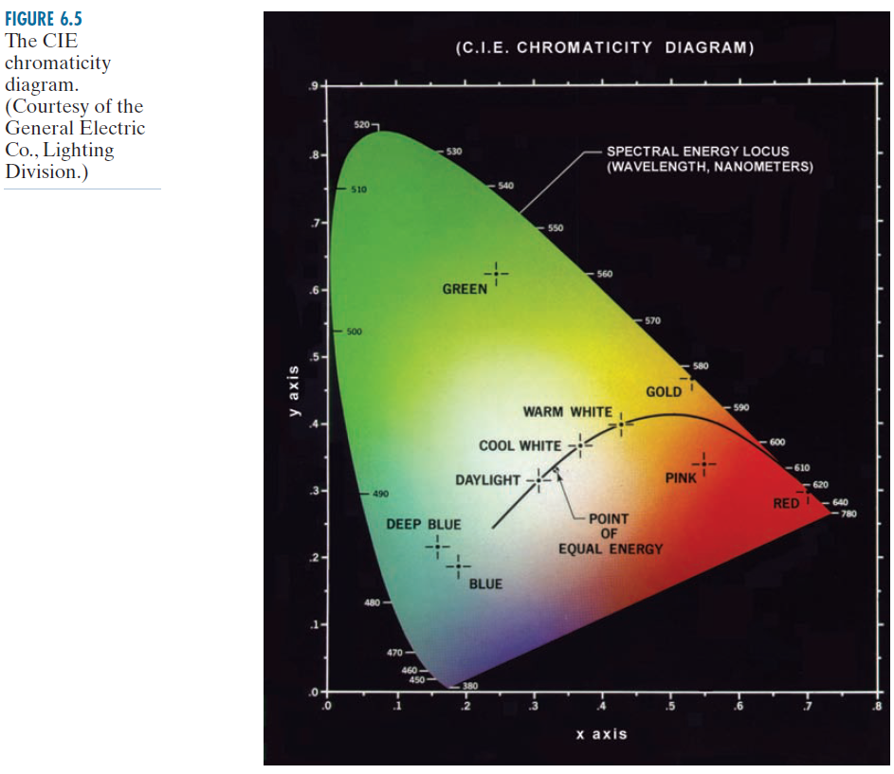
Module - 1 Digital Image Fundamentals

Slide 120
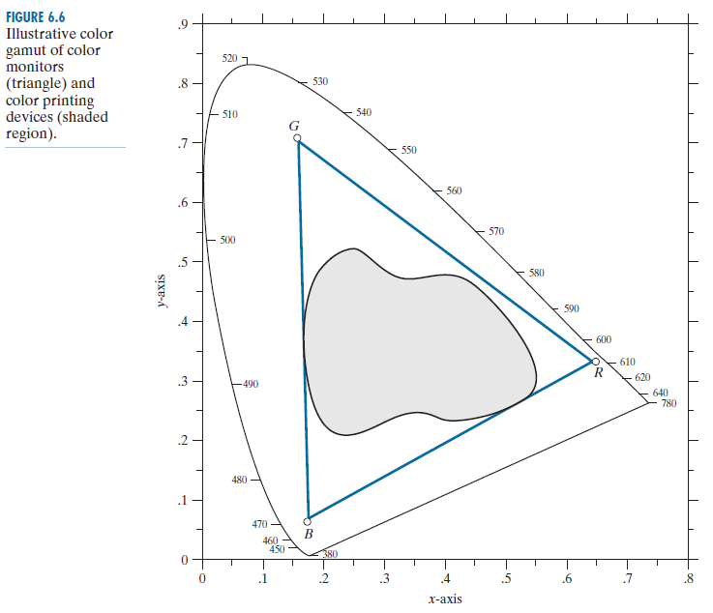
Module - 1 Digital Image Fundamentals

Slide 121
Module - 1 Digital Image Fundamentals
Color Image Processing
Color Fundamentals
CIE Chromaticity Diagram
A triangle with vertices at any three fixed colors
Cannot enclose the entire color region in Fig. 6.5
Not all colors can be obtained with three single, fixed primaries, because three colors form a triangle
The triangle in Fig. 6.6
Shows a range of colors (called the color gamut) produced by RGB monitors
The shaded region inside the triangle
Illustrates the color gamut of today’s high-quality color printing devices
The boundary of the color printing gamut
Irregular
Color printing is a combination of additive and subtractive color mixing
Process that is much more difficult to control than that of displaying colors on a monitor
Based on the addition of three highly controllable light primaries

